Slide 1

Data Structures
Ms. Priyanka M
Assistant Professor
Dept. of MCA
School of Computing
Amrita Vishwa Vidyapeetham
Mysuru Campus

Slide 2

Data
Information
115
cm

Slide 3

Data

Slide 4



Organized Data
Quick access
Effective Memory Utilization
Better Performance
Data Structure

Slide 5

Data structures

Slide 6
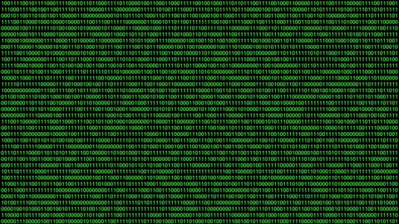
Memory Organization
1 byte

Slide 7




Primitive Data Structure

Slide 8
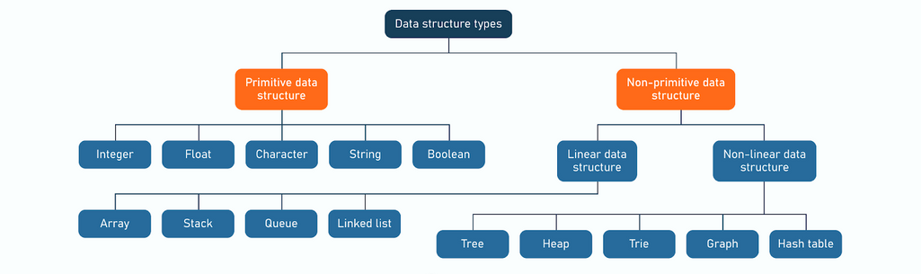
Data Structure Classification

Slide 9
Data Structure
Mathematical view
Domain : Knowledge on problem
Functions: set of operations
Axioms: rules or properties that must always hold true

Slide 10
Abstract Data Type
An ADT is a mathematical model of a data structure that defines:
The data it can store.
The operations that can be performed on that data.
It does not specify implementation details, only the "what" (behavior), not the "how".

Slide 11

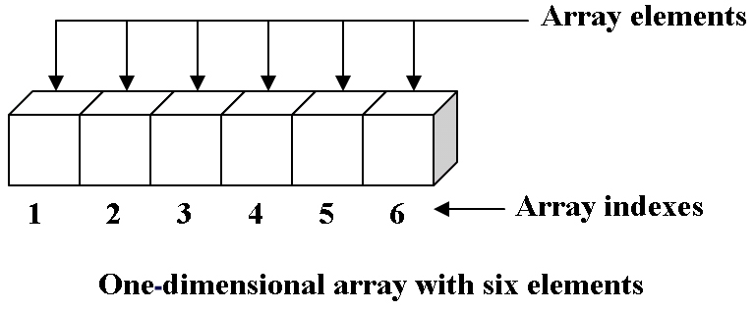


Array
Applications
Array is a linear data structure where all elements are arranged sequentially. It is a collection of elements of same data type stored at contiguous memory locations.

Slide 12
Characteristics of arrays
Homogeneous Data Structure: All elements must be of the same data type (e.g., all integers or all floats).
Contiguous Memory Allocation: All elements are stored sequentially in memory, enabling fast access.
Fixed Size: The size of an array is defined at compile-time and cannot be changed dynamically.
Index-Based Access: Array elements are accessed directly using their index — O(1) time access.
Efficient Traversal: Can easily iterate through all elements using loops.
Random Access: Any element can be accessed instantly using its index number.
Static Data Structure: Size is fixed and memory is allocated before execution (compile-time).
Single and Multi-Dimensional: Arrays can be: 1D (e.g., list of numbers), 2D (e.g., matrix), 3D digital Image or higher-dimensional for complex data.

Slide 13
Memory Representation/ Address Calculation
Let:
Base address = BA (starting address of array in memory)
Size of each element = w (in bytes)
Dimensions = m × n (m - rows, n - columns)
Index position = (i, j) (0-based indexing)
1. Row-major formula (C/C++):
LOC(A[i][j])=BA + w × (i×n + j)
2. Column-major formula (Fortran/MATLAB):
LOC(A[i][j])=BA + w × (i + j×m)

Slide 14
Example
Consider, int A[3][4]
Assume: BA = 1000, w = 4 bytes.
Find address of A[2][1].
👉 Row-major:
LOC (A[2][1]) = 1000+((2 × 4)+1) × 4 = 1000+(8+1) × 4 = 1000+36 = 1036
👉 Column-major:
LOC (A[2][1]) = 1000+((1 × 3)+2) × 4 = 1000+(3+2) × 4 = 1000+20 = 1020

Slide 15
Linear Search
Input: arr[size], key
Output: key found or not
Method:
LinearSearch(arr, key)
{
for (i = 0; i <size; i++)
if (arr[i] == key)
{
flag = 1
break
}
}

Slide 16
Binary Search
Input: arr[size], key
Output: key found or not
Method:BinarySearch(arr[], key)
{
low = 0, high = size - 1;
while (low <= high)
{
mid = (low + high) / 2;
if (arr[mid] == key)
return mid; // key found, return index
if (arr[mid] < key)
low = mid + 1; // search right half
else
high = mid - 1; // search left half
}
}

Slide 17
Binary Search with Recursive Function
binarySearch(int arr[], int low, int high, int key) {
int mid;
mid = (low + high) / 2;
if (low > high)
return -1; // key not found
else if (arr[mid] == key)
return mid; // key found
else if (arr[mid] < key)
return binarySearch(arr, mid + 1, high, key); // search right half
else
return binarySearch(arr, low, mid - 1, key); // search left half
}

Slide 18

Bubble Sort
for (i = 0; i<n; i++)
for (j = 0; j < n-i-1; j++)
if (arr[j] > arr[j+1])
{
temp = arr[j];
arr[j] = arr[j + 1];
arr[j + 1] = temp;
}
Time Complexity:
Best Case:
O(n) => With an optimized version
Worst Case:
O($n^{2}$) => Element found at the end
Average Case:
O($n^{2}$)

Slide 19
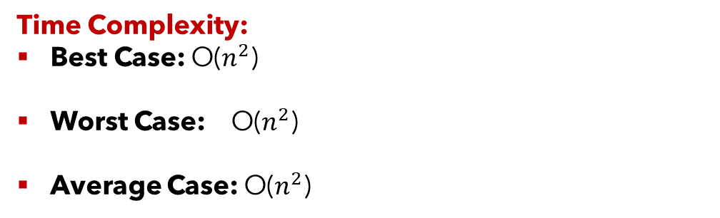
Selection sort
for (i = 0; i<n; i++)
{
min = i;
for (j = i+1;j < n; j++)
if (arr[j] < arr[min])
min = j;
temp = arr[i];
arr[i]=arr[min];
arr[min]=temp;
}
Time Complexity:
Best Case: O($n^{2}$)
Worst Case: O($n^{2}$)
Average Case: O($n^{2}$)

Slide 20
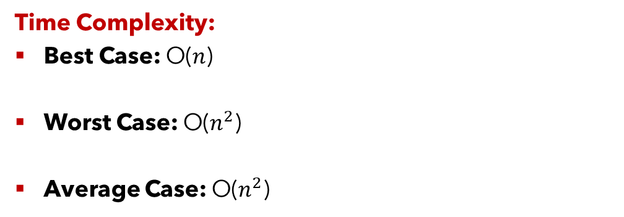
Insertion Sort
for (i = 1; i < n; i++)
{
key = arr[i];
j=i-1;
while (j >= 0 && arr[j] > key)
{
arr[j+1] = arr[j];
j=j-1;
}
arr[j+1] = key;
}
Time Complexity:
Best Case: O($n$)
Worst Case: O($n^{2}$)
Average Case: O($n^{2}$)

Slide 21
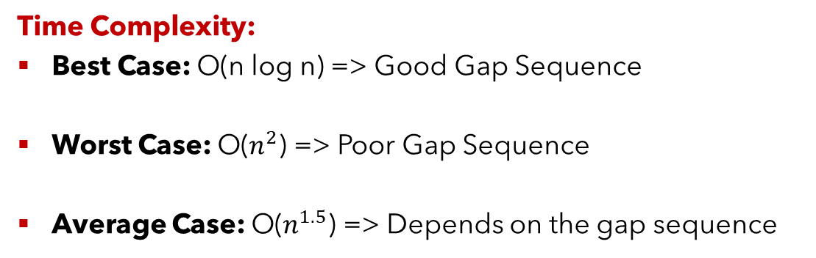
Shell Sort
Diminishing Increment Sort/ n-gap insertion sort
ShellSort(int arr[], int n)
{
for (gap = n / 2; gap > 0; gap /= 2)
for (int i = gap; i < n; i++)
for (j = i - gap; j >= 0; j = j - gap)
if (a[j+gap]>a[j]) then
break
else
swap (arr[j+gap], arr[j])
}
Time Complexity:
Best Case: O(n log n) => Good Gap Sequence
Worst Case: O($n^{2}$) => Poor Gap Sequence
Average Case: O($n^{1.5}$) => Depends on the gap sequence

Slide 22










Linked List

Slide 23

Linked List

Slide 24
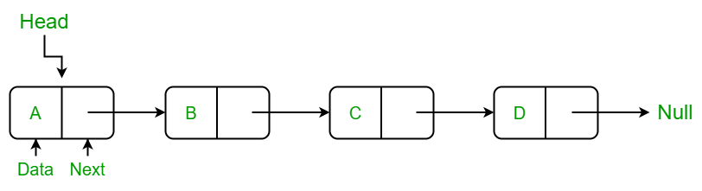
Single Linked List (SLL)
A Single Linked List (SLL) is a linear data structure in which elements are stored in nodes, and each node contains:
Data – the actual value.
Pointer (link) – the address of the next node in the list.
Unlike arrays, linked lists do not store elements in contiguous memory. Instead, each node points to the next, forming a chain-like structure.
Structure of a Node in C:
struct node {
int data; // Here, data → stores the actual value.
struct node *link; //next → pointer to the next node.
};

Slide 25
Memory Representation
A linked list stores elements dynamically in non-contiguous memory locations. Each node is connected via pointers.
Example: Let’s say we insert: 10 → 20 → 30
Memory representation:
Pointer chain: Head → [10 | 2002] → [20 | 3003] → [30 | NULL]
Diagrammatically:
Head
↓
[10 | *] → [20 | *] → [30 | NULL]
Node | Data | Next (Address)
N1 (1001) | 10 | 2002
N2 (2002) | 20 | 3003
N3 (3003) | 30 | NULL

Slide 26
Applications of Single Linked List
Dynamic Memory Management – Efficient allocation/deallocation of memory at runtime.
Implementation of Stacks and Queues – Using pointers instead of arrays.
Polynomial Representation – Each term can be represented as a node.
Symbol Tables and Hash Tables – Used in compilers and interpreters.
Navigation Systems – For maintaining a sequence of locations.
Music/Video Playlists – Tracks can be stored and linked dynamically.

Slide 27
Advantages and Disadvantages
Advantages
Dynamic Size – Memory grows or shrinks as needed (no pre-allocation).
Efficient Insertion/Deletion – Especially at the beginning or middle.
Memory Utilization – No wasted space (unlike arrays).
Ease of Implementation – Useful for implementing dynamic structures like stacks, queues, and graphs.
Disadvantages
No Random Access – You must traverse sequentially (O(n) time).
Extra Memory Overhead – Each node stores an additional pointer.
Reverse Traversal Not Possible – As links are unidirectional.
Complex Implementation – Compared to arrays for simple tasks.
Cache Unfriendliness – Non-contiguous memory reduces access speed.

Slide 28
Operation
Operation | Description | Time Complexity
Insert at Beginning | Add a new node at start | O(1)
Insert at End | Add node at tail | O(n)
Insert at Position | Add node at a specific index | O(n)
Delete at Beginning | Remove first node | O(1)
Delete at End | Remove last node | O(n)
Delete at Position | Remove specific node | O(n)
Search | Find element | O(n)
Traverse | Display all nodes | O(n)

Slide 29
Inserting an item into a Singly Linked List
There are different types of insertions:
Insert a node at the beginning of the linked list
Insert the node at the end of the linked list
Insert a node at a specified position in the linked list

Slide 30
Inserting a node at the beginning of the SLL
Consider the following linked list
Create memory for the new node
Assign the value to the data field of the new node
Make the link field of the new node to point to the starting node of the linked list
Set the head pointer (which was pointing to the first node) to point to the new node

Slide 31
Inserting a node at the end of the SLL
Consider the following linked list
Create memory for the new node
Assign the value to the data field of the new node
Make the link field NULL
Go to the last node with the help of another pointer called temp
Insert the new node after the last node

Slide 32
Inserting a node at a specified position of the SLL
Create memory for the new node
Assign the value to the data field of the new node
Search the nodeA with the help of the pointer temp
If there is no nodeA in the list, then the position entered is out of range
Make the link field of the new node to point to nodeB
Make the link field of nodeA to point to the new node

Slide 33
Deleting an item into a Singly Linked List
The deletion operation is classified into following types:
Deletion of first node
Deletion of last node
Deleting the node at a specified position

Slide 34
---------------- DELETION PHASE ---------------
printf("Nodes in the list\n");
display(head);
do {
if (head == NULL) {
printf("List is empty! Nothing to delete.\n");
break;
}
printf("Current number of elements: %d\n", count);
printf("Enter position to delete (1 to %d): ", count);
scanf("%d", &pos);

Slide 35
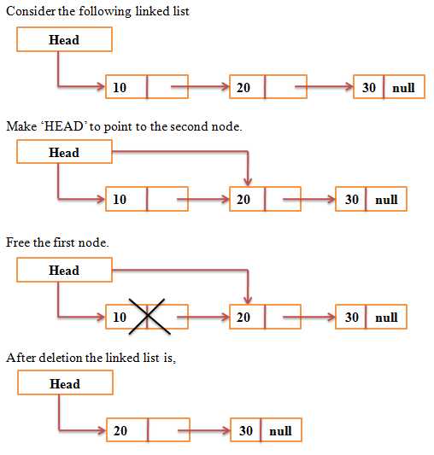
Deleting a node at the beginning of the SLL
Check whether the list is empty or not
Make HEAD to point to the second node
Free the first node

Slide 36
Deleting a node at the beginning of the SLL
if (pos == 1) {
temp = head;
head = head->link;
printf("Deleted %d\n", temp->data);
free(temp);
}

Slide 37
Deleting a node at the end of the SLL
Check whether the list is empty or not
Go to traversing the list till the last but one node
Set the link field of the last but one node to NULL
Free the last node

Slide 38
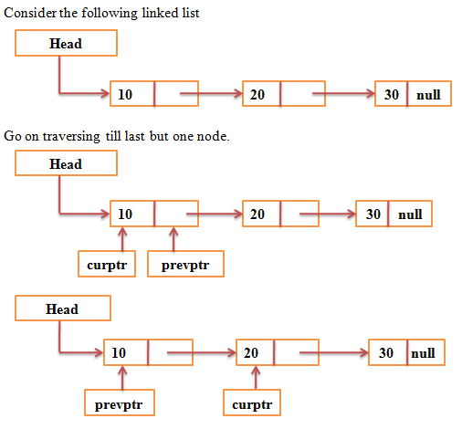
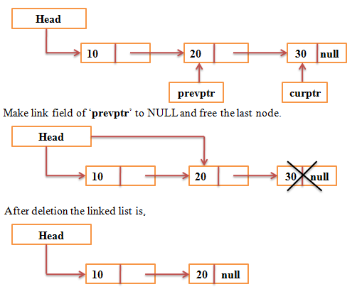
Deleting a node at the end of the SLL

Slide 39
Deleting a node at the end of the SLL
else if (pos >= count) {
struct Node* prev = NULL;
temp = head;
while (temp->link != NULL) {
prev = temp;
temp = temp->link;
}
if (prev != NULL)
prev->link = NULL;
else
head = NULL;
printf("Deleted %d\n", temp->data);
free(temp);
}

Slide 40
Deleting a node at a specified position of the SLL
Check whether the list is empty or not
Search the desired node
Check whether the specified node is present in the first
Make the link field of nodeA to point to nodeB
Free the node between nodeA and nodeB

Slide 41
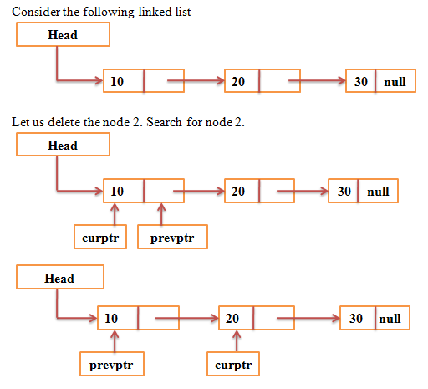
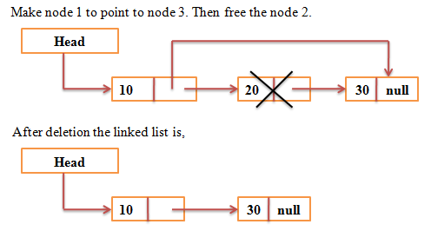
Deleting a node at a specified position of the SLL

Slide 42
Deleting a node at a specified position of the SLL
else {
struct Node* prev = head;
temp = head;
for (i = 1; i < pos; i++) {
prev = temp;
temp = temp->link;
}
prev->link = temp->link;
printf("Deleted %d\n", temp->data);
free(temp);
}
count--;
display(head);
if (head == NULL) {
printf("List is now empty.\n");
break;
}
printf("Do you want to delete another node? (y/n): ");
scanf(" %c", &choice);
} while (choice == 'y' || choice == 'Y');
printf("Program terminated.\n");

Slide 43
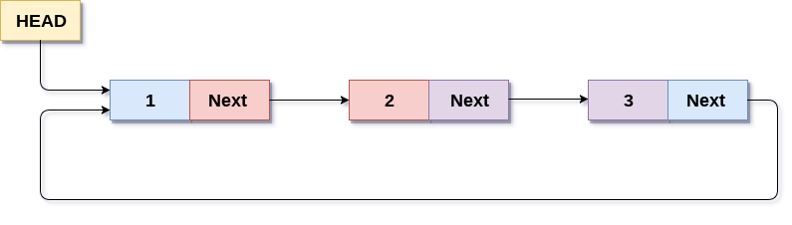
Circular Single Linked List (CSLL)
A linked list where the last node points back to the first node (head) instead of NULL.
This makes the list circular and allows traversal starting from any node.
SLL ends with NULL, CSLL ends with head.
Insert/Delete at beginning or end require updating last nodes next.
Syntax:
struct node {
int data;
struct node *link;
};
struct node *head = NULL;

Slide 44
Key Characteristics of CSLL
Circular Structure: The defining feature is the loop where the end of the list connects back to the beginning.
One-Way Traversal: Similar to a singly linked list, traversal can only occur in one direction (from head to tail and then back to head).
No NULL pointer: No node in a CSLL has a NULL pointer in its next field, as every node has a successor.
Node Structure: Each node typically contains a data element and a pointer (often named link or next) to the subsequent node in the sequence.

Slide 45
Advantages and Disadvantages of CSLL
Advantages:
Continuous Traversal: Enables continuous iteration through the list without needing to explicitly check for the end.
Efficient Operations at Both Ends: Operations like insertion or deletion at the beginning or end can be more efficient than in a standard singly linked list, especially when a pointer to the last node is maintained.
Round-Robin Applications: Well-suited for scenarios like round-robin scheduling or managing a circular buffer.
Disadvantages:
Infinite Loop Risk: Care must be taken during traversal to avoid infinite loops, requiring a condition to stop after visiting all nodes.
Complexity in Deletion: Deleting nodes can be more complex, especially when dealing with the last node or the only node in the list, as pointer adjustments need to maintain the circularity.

Slide 46
Comparison between SLL and CSLL
Sl. No. | Operation | SLL Logic Ends With… | CSLL Logic Ends With…
1 | End Node Pointer | NULL | head
2 | Traversal | while (temp != NULL) | do {...} while(temp != head)
3 | Insert/Delete at Begin | Simple head change | Must also update last node’s link
4 | Loop Control | Stops at NULL | Stops when back at head

Slide 47
Insert at beginning
void beg_ins() {
struct node *new, *temp;
int item;
new = (struct node *)malloc(sizeof(struct node));
if (new == NULL) {
printf("\nOVERFLOW");
return;
}
printf("\nEnter value: ");
scanf("%d", &item);
new->data = item;
if (head == NULL) {
head = new;
new->link = head;
}
else {
temp = head;
while (temp->link != head) {
temp = temp->link;
}
new->link = head;
temp->link = new;
head = new;
}
printf("\nNode with value %d inserted at position 1", item);
}

Slide 48
Insert at end
void lst_ins() {
struct node *new, *temp;
int item, pos = 1;
new = (struct node *)malloc(sizeof(struct node));
if (new == NULL) {
printf("\nOVERFLOW");
return;
}
printf("\nEnter value: "); scanf("%d", &item);
new->data = item;
if (head == NULL) {
head = new;
new->link = head;
printf("\nNode with value %d inserted at position 1", item);
}
else {
temp = head;
while (temp->link != head) {
temp = temp->link;
pos++;
}
temp->link = new;
new->link = head;
printf("\nNode with value %d inserted at position %d", item, pos + 1);
}
}

Slide 49
Insert at random position
void ran_ins() {
struct node *new, *temp;
int i, loc, item;
new = (struct node *)malloc(sizeof(struct node));
if (new == NULL) {
printf("\nOVERFLOW");
return;
}
printf("\nEnter value: "); scanf("%d", &item);
new->data = item;
printf("\nEnter the position (starting from 1): ");
scanf("%d", &loc);
if (loc == 1) {
beg_ins();
return; }
temp = head;
for (i = 1; i < loc - 1; i++) {
temp = temp->link;
if (temp == head) {
printf("\nCan't insert, position out of range");
return;
}
}
new->link = temp->link;
temp->link = new;
printf("\nNode with value %d inserted at position %d", item, loc);
}

Slide 50
Delete from beginning
void beg_del() {
struct node *temp, *last;
if (head == NULL) {
printf("\nList is empty");
return;
}
int val = head->data;
if (head->link == head) { // single node
free(head);
head = NULL;
}
else {
temp = head;
last = head;
while (last->link != head) {
last = last->link;
}
head = head->link;
last->link = head;
free(temp);
}
printf("\nNode with value %d deleted from position 1", val);
}

Slide 51
Delete from end
void lst_del() {
struct node *temp, *prev;
if (head == NULL) {
printf("\nList is empty");
return;
}
int pos = 1, val;
if (head->link == head) { // single node
val = head->data;
free(head);
head = NULL;
printf("\nNode with value %d deleted from position 1", val);
}
else {
temp = head;
while (temp->link != head) {
prev = temp;
temp = temp->link;
pos++;
}
val = temp->data;
prev->link = head;
free(temp);
printf("\nNode with value %d deleted from position %d", val, pos);
}
}

Slide 52
Delete at random position
void ran_del() {
struct node *temp, *prev;
int loc, i, val;
if (head == NULL) {
printf("\nList is empty");
return;
}
printf("\nEnter the position to delete: ");
scanf("%d", &loc);
if (loc == 1) {
beg_del();
return;
} temp = head;
for (i = 1; i < loc; i++) {
prev = temp;
temp = temp->link;
if (temp == head) {
printf("\nCan't delete, position out of range");
return;
}
}
val = temp->data;
prev->link = temp->link;
free(temp);
printf("\n %d deleted from position %d", val, loc);
}

Slide 53
Delete at random position
void ran_del() {
struct node *temp, *prev;
int loc, i, val;
if (head == NULL) {
printf("\nList is empty");
return;
}
printf("\nEnter the position (starting from 1) to delete: ");
scanf("%d", &loc);
if (loc == 1) {
beg_del();
return;
} temp = head;
for (i = 1; i < loc; i++) {
prev = temp;
temp = temp->link;
if (temp == head) {
printf("\nCan't delete, position out of range");
return;
}
}
val = temp->data;
prev->link = temp->link;
free(temp);
printf("\nNode with value %d deleted from position %d", val, loc);
}

Slide 54
Searching
void search() {
struct node *temp;
int item, i = 1, flag = 0;
if (head == NULL) {
printf("\nEmpty List");
return;
}
printf("\nEnter item to search: ");
scanf("%d", &item);
temp = head;
do {
if (temp->data == item) {
printf("\nItem %d found at position %d", item, i);
flag = 1;
break;
}
temp = temp->link;
i++;
} while (temp != head);
if (flag == 0)
printf("\nItem %d not found", item);
}

Slide 55
Traversal
void display() {
struct node *temp;
int pos = 1;
if (head == NULL) {
printf("\nNothing to display");
return; }
printf("\nValues in the Circular List:\n");
temp = head;
do {
printf("[%d] %d -> ", pos, temp->data);
temp = temp->link;
pos++;
} while (temp != head);
printf("(back to head)\n");
}

Slide 56
Applications of CSLL
CPU Scheduling
Media Players
Multi-player Games
Buffer Management
Time-Sharing Systems
Embedded Systems
Sensor Data

Slide 57
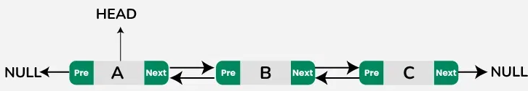
Double Linked List (DLL)
A doubly-linked list is a type of linked list where each node has two pointers: one pointing to the next node in the sequence and another pointing to the previous node.
Unlike a Singly Linked List (SLL) which can only be traversed in one direction (forward), a DLL allows bi-directional traversal — both forward and backward — because each node maintains a link to both its previous and next nodes.
Syntax:
struct node {
int data;
struct node *llink; // previous node
struct node *rlink; // next node
}; struct node *head = NULL;

Slide 58
Characteristics of Doubly Linked List
Sl. No. | Feature | Description
1 | Bi-directional traversal | Each node can be accessed from both directions (forward and backward).
2 | Two pointers per node | Each node contains a prev pointer (to previous node) and a next pointer (to next node).
3 | Dynamic size | The list size can grow or shrink during execution as memory is allocated/deallocated dynamically.
4 | No contiguous memory allocation | Nodes are stored randomly in memory and connected via pointers.
5 | More memory usage than SLL | Since each node stores an additional pointer (prev), DLL uses extra memory.
6 | Ease of insertion/deletion | Insertion and deletion operations are easier as we can access both neighboring nodes.
7 | Complex implementation | Managing both prev and next pointers correctly requires careful programming.

Slide 59
Advantages and disadvantages of DLL
Advantages of Doubly Linked List
Can be traversed in both directions.
Insertion and deletion are easier compared to singly linked lists (especially at the end).
Reversing the list can be done more efficiently.
Can easily insert or delete before or after a given node.
Disadvantages
Requires more memory (extra prev pointer per node).
Slightly more complex to implement due to pointer management.
Extra time is needed to update both pointers during insertion/deletion.

Slide 60
Applications of DLL
Application Area
Navigation systems
Undo/Redo functionality
Music or video players
Implementing Deques
Memory management
Graph traversal
Complex data structures

Slide 61
Insert at beginning
void beg_ins() {
int value; struct node *newNode;
printf("Enter value to insert at beginning: ");
scanf("%d", &value);
newNode = createNode(value);
if (head == NULL)
head = newNode;
else {
newNode->rlink = head;
head->llink = newNode;
head = newNode;
}
printf("Inserted %d at beginning.\n", value);
}

Slide 62
Insert at end
void lst_ins() {
int value;struct node *newNode;
printf("Enter value to insert at end: ");
scanf("%d", &value);
newNode = createNode(value);
if (head == NULL)
head = newNode;
else {
struct node *temp = head;
while (temp->rlink != NULL)
temp = temp->rlink;
temp->rlink = newNode;
newNode->llink = temp;
}
printf("Inserted %d at end.\n", value);
}

Slide 63
Insert at random position
void ran_ins() {
int pos, value, i = 1; struct node *newNode, *temp, *next;
printf("Enter position to insert: ");
scanf("%d", &pos);
printf("Enter value to insert: ");
scanf("%d", &value);
newNode = createNode(value);
if (pos == 1) {
beg_ins(); return;
}
temp = head;
while (i < pos - 1 && temp != NULL) {
temp = temp->rlink;
i++;
}
if(temp == NULL) {
printf("Invalid position.\n");
free(newNode);
return;
}
next = temp->rlink;
newNode->rlink = next;
newNode->llink = temp;
if(next != NULL)
next->llink = newNode; // update next node’s prev link
temp->rlink = newNode;
printf("Inserted %d at position %d.\n", value, pos);
}

Slide 64
Delete from beginning
void beg_del() {
struct node *temp;
if (head == NULL) {
printf("List is empty.\n");
return;
}
temp = head;
printf("Deleted %d from beginning.\n", temp->data);
if (temp->rlink == NULL)
head = NULL;
else {
struct node *newHead = temp->rlink;
newHead->llink = NULL; // break backward link
head = newHead;
}
free(temp);
}

Slide 65
Delete from end
void lst_del() {
struct node *temp, *prev;
if (head == NULL) {
printf("List is empty.\n");
return; }
temp = head;
if (temp->rlink == NULL) {
printf("Deleted %d from end.\n", temp->data);
free(temp);
head = NULL;
return; }
while (temp->rlink != NULL)
temp = temp->rlink;
printf("Deleted %d from end.\n", temp->data);
prev = temp->llink;
prev->rlink = NULL; // disconnect the last node
free(temp);
}

Slide 66
Delete from any position
void ran_del() {
int pos, i = 1;
struct node *temp, *prev, *next;
if (head == NULL) {
printf("List is empty.\n");
return; }
printf("Enter position to delete: ");
scanf("%d", &pos);
temp = head;
if (pos == 1) {
beg_del(); return; }
while (i < pos && temp != NULL) {
temp = temp->rlink;
i++;
}
if (temp == NULL) {
printf("Invalid position.\n");
return; }
printf("Deleted %d from position %d.\n", temp->data, pos);
prev = temp->llink;
next = temp->rlink;
if (prev != NULL)
prev->rlink = next; // update forward link
if (next != NULL)
next->llink = prev; // update backward link
free(temp);
}

Slide 67
Search for an element
void search() {
int value, pos = 1, flag = 0; struct node *temp;
if (head == NULL) {
printf("List is empty.\n");
return; }
printf("Enter value to search: ");
scanf("%d", &value);
temp = head;
while (temp != NULL) {
if (temp->data == value) {
printf("Element %d found at position %d.\n", value, pos);
flag = 1; }
temp = temp->rlink;
pos++; }
if (flag == 0)
printf("Element %d not found in the list.\n", value);
}

Slide 68
Display all elements
void display() {
struct node *temp;
if (head == NULL) {
printf("List is empty.\n");
return;
}
temp = head;
printf("Doubly Linked List: ");
while (temp != NULL) {
printf("%d <-> ", temp->data);
temp = temp->rlink;
}
printf("NULL\n");
}

Slide 69


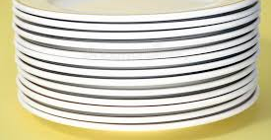

Stack
POP
PUSH

Slide 70
Stack
A Stack is a linear data structure that follows the LIFO (Last In, First Out) principle — the last element inserted into the stack is the first one to be removed.
Characteristics of Stack
Linear structure: Elements are arranged sequentially.
LIFO principle: The last inserted element is the first removed.
Single access point: Insertion and deletion happen only at one end called the top.
Limited size: Stack overflow occurs when you try to push into a full stack.
Efficient operations: Push and Pop operations take O(1) time.

Slide 71
Applications of Stack
Expression Evaluation | Used in evaluating postfix/prefix expressions.
Expression Conversion | Convert infix to postfix/prefix notation.
Function Call Management | Used in managing function call stacks (recursion).
Undo/Redo Operations | In text editors or software applications.
Browser History | Tracks the pages visited using a stack mechanism.
Parenthesis Matching | Validates balanced parentheses in an expression.
Browser History Navigation | Helps move backward/forward between pages.
Reversing Data | Useful for reversing strings or lists.

Slide 72
Basic Stack Operations
Operation | Description
push() | Insert (add) an element at the top of the stack.
pop() | Remove (delete) the top element of the stack.
peek() / top() | Retrieve the top element without removing it.
isEmpty() | Check if the stack is empty.
isFull() | Check if the stack is full (for array implementation).
display()/ traverse() | Print all elements of the stack.

Slide 73
Push/ Insertion
void push(int value) {
if (top == SIZE - 1) {
printf("Stack Overflow! Cannot push %d\n", value);
} else {
top++;
stack[top] = value;
printf("%d pushed to stack.\n", value);
}
}

Slide 74
Pop/ Deletion
void pop() {
if (top == -1) {
printf("Stack Underflow! Stack is empty.\n");
} else {
printf("%d popped from stack.\n", stack[top]);
top--;
}
}

Slide 75
Peek
void peek() {
if (top == -1)
printf("Stack is empty.\n");
else
printf("Top element is %d\n", stack[top]);
}

Slide 76
Display/ Traversal
void display() {
if (top == -1) {
printf("Stack is empty.\n");
} else {
printf("Stack elements are: ");
for (int i = top; i >= 0; i--)
printf("%d ", stack[i]);
printf("\n");
}
}

Slide 77
Stack using Linked List
Push() – Insertion in the beginning
Pop() – Deletion from the beginning
Traverse() – Display using linked list

Slide 78
Expression
An expression is a combination of operands and operators that produces a value when evaluated.
Example: a + b * c
Components of an Expression
Operands – Variables or constants (e.g., x, 5, y).
Operators – Symbols that perform operations (e.g., +, -, *, /, =).
Result – Value obtained after evaluation.

Slide 79
Types of Expression Notations
Type | Format | Example | Evaluation Order | Used In
Infix | A + B * C | operator in-between operands | Depends on precedence | Human readable, programming languages
Prefix | + A * B C | operator followed by operands | Right to left | Compilers, Lisp
Postfix | A B C * + | operands followed by operator | Left to right | Stack evaluation, calculators
Infix Expression
A + (B * C)
Tree Representation:
+
/ \
A *
/ \
B C
Prefix Expression
Conversion Rule: Move the operator before its operands.
Infix: A + B * C Prefix: + A * B C
Postfix Expression
Conversion Rule: Move the operator after its operands.
Infix: A + B * C Postfix: A B C * +

Slide 80
Infix to postfix conversion
Infix Expression
Operator is in between operands.
Example: A + B * C
Postfix Expression (Reverse Polish Notation)
Operator comes after operands.
Equivalent Postfix: A B C * +
Step | Symbol | Stack | Output
1 | A | — | A
2 | + | + | A
3 | B | + | A B
4 | * | + * | A B
5 | C | + * | A B C
6 | — | — | A B C * +

Slide 81
Infix to postfix conversion
If the symbol is an operand, add it directly to the postfix expression.
If the symbol is an operator:
Pop operators from the stack with greater or equal precedence and append them to postfix.
Then push the current operator.
If ‘(‘ is encountered, push it to stack.
If ‘)’ is encountered, pop and output from the stack until a ( is found.
At the end, pop all remaining operators from the stack and append them to postfix.
Operator Precedence and Associativity
Operator | Precedence | Associativity
^ | Highest | Right
*, / | Medium | Left
+, - | Lowest | Left

Slide 82
Infix to postfix conversion
void infixToPostfix(char infix[]) { // Function to convert infix to postfix
char postfix[MAX], symbol, temp; int i, k = 0;
for (i = 0; infix[i] != '\0'; i++) {
symbol = infix[i];
if (isalnum(symbol)) // If operand, add to postfix expression
postfix[k++] = symbol;
else if (symbol == '(') // If '(', push to stack
push(symbol);
else if (symbol == ')') { // If ')', pop and output until '('
while ((temp = pop()) != '(')
postfix[k++] = temp;
}
else { // If operator, pop higher precedence operators and push current
while (precedence(stack[top]) >= precedence(symbol))
postfix[k++] = pop();
push(symbol);
}
}
while (top != -1) { // Pop remaining operators
postfix[k++] = pop();
}
postfix[k] = '\0'; // null terminate
printf("Postfix Expression: %s\n", postfix);
}
void main() {
char infix[MAX];
int top = -1;
printf("Enter an Infix Expression: ");
scanf("%s", infix);
infixToPostfix(infix);
}

Slide 83
Infix to postfix conversion
void push(char c) { // Function to push element to stack
if (top == MAX - 1) {
printf("Stack Overflow\n");
return;
}
stack[++top] = c;
}
char pop() { // Function to pop element from stack
if (top == -1) {
return -1;
}
return stack[top--];
}
int precedence(char symbol) { // Function to return precedence of operators
switch (symbol) {
case '^': return 3;
case '*':
case '/': return 2;
case '+':
case '-': return 1;
default: return 0;
}
}

Slide 84
Postfix Evaluation
void push(int item) {
if (top >= MAX_SIZE - 1) {
printf("Stack Overflow!\n");
exit(1);
}
stack[++top] = item;
}
int pop() {
if (top < 0) {
printf("Stack Underflow!\n");
exit(1);
}
return stack[top--];
}

Slide 85
Postfix Evaluation
int evaluatePostfix(char* postfix) {
int i = 0, operand1, operand2, result;
char ch;
while ((ch = postfix[i++]) != '\0') {
if (isdigit(ch))
push(ch - '0');
else {
operand2 = pop();
operand1 = pop();
switch (ch) {
case '+': result = operand1 + operand2; break;
case '-': result = operand1 - operand2; break;
case '*': result = operand1 * operand2; break;
case '/': result = operand1 / operand2; break;
default: printf("Invalid operator: %c\n", ch);
exit(1);
}
push(result);
}
}
return pop();
}

Slide 86
Tower of Hanoi
void TowerOfHanoi(int n, char src, char tmp, char dst)
{
if (n == 1)
printf("\n Move disk %d from %c to %c", n, src, dst);
else{
towerOfHanoi(n - 1, src, dst, tmp);
towerOfHanoi(1, src, tmp, dst);
towerOfHanoi(n - 1, tmp, src, dst);
}
}
void main() {
TowerOfHanoi(n, 'S', 'T', 'D’); //function call
}

Slide 87
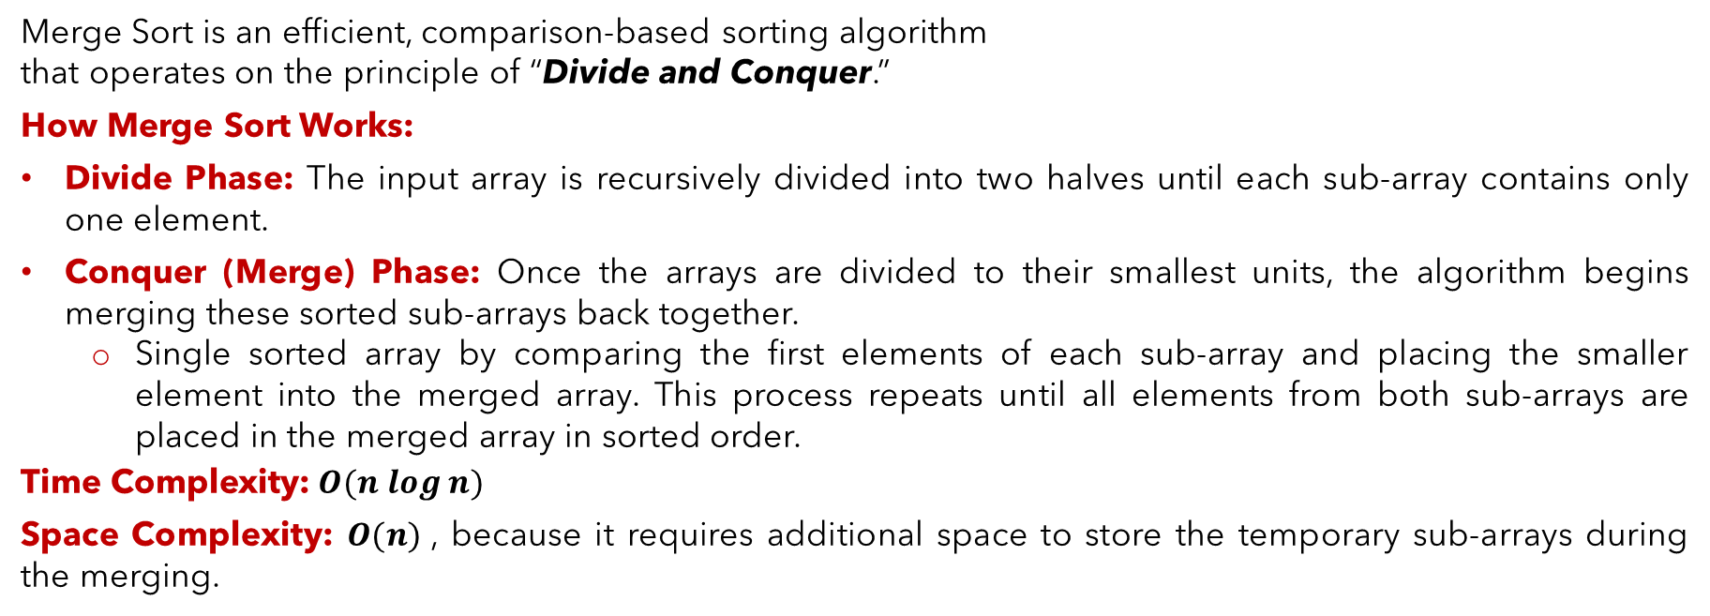
Merge Sort
Merge Sort is an efficient, comparison-based sorting algorithm
that operates on the principle of “Divide and Conquer.”
How Merge Sort Works:
Divide Phase: The input array is recursively divided into two halves until each sub-array contains only one element.
Conquer (Merge) Phase: Once the arrays are divided to their smallest units, the algorithm begins merging these sorted sub-arrays back together.
Single sorted array by comparing the first elements of each sub-array and placing the smaller element into the merged array. This process repeats until all elements from both sub-arrays are placed in the merged array in sorted order.
Time Complexity:$O(n log⁡n)$
Space Complexity: $O(n)$, because it requires additional space to store the temporary sub-arrays during the merging.

Slide 88
Merge sort
merge(arr[], low, mid, high) {
i = low, j = mid+1, k = low
while (i ≤ mid && j ≤ high)
{
if (arr[i] < arr[j]) {
temp[k] = arr[i]
i++ }
else {
temp[k] = arr[j]
j++ }
k++
}
while (i ≤ mid) {
temp[k] = arr[i]
i++, k++ }
while (j ≤ high) {
temp[k] = arr[j]
j++, k++ }
}
mergeSort(arr[], low, high)
{
if (low < high)
{
int mid = (low + high )/ 2;
mergeSort(arr, low, mid);
mergeSort(arr, mid + 1, high);
merge(arr, low, mid, high);
}
}

Slide 89


Queue

Slide 90

Thank you

